Slide 1
Automation Surprises
Joint Cognitive Systems: Patterns in Cognitive Systems Engineering

Slide 2
“The operator’s job is to make up for holes in designers’ work,” Jens Rasmussen. (context: nuclear plant systems operations).
Several Naval Nuclear Incident reports due to an important indication not being at eye level.
Observations reveal that change represents new ways of doing things; i.e., it does not preserve the old ways with the simple substitution of one medium for another or one agent for another.
Increased computational power and visualization techniques (2D → 3D modeling)

Slide 3
New computerized and automated devices also create new burdens and complexities for the individuals and teams of practitioners responsible for operating, troubleshooting, and managing high-consequence systems.
Upgraded throttle control and inadequate training on the system resulted in a probable death of a whale
Automation surprises begin with miscommunication and misassessments between the automation and users which lead to a gap between the user’s understanding of what the automated systems are set up to do, what they are doing, and what they are going to do.
An extreme fictional case David Bowman and Hal (2001: A Space Odyssey)

Slide 4
Escalating demands as events cascade relates to the phenomenon of clumsy automation.
Designing to ideal conditions and not worst or corner case situations.
Adaptation occurs in order for practitioners to cope with the complexities introduced by clumsy use of technology that is ill-fit to the demands of work.
Screens in maneuvering for throttlemen, even 2D plots with ship orientation might preserve marine life.
Practitioner adaptations have revealed automation that is poorly designed for the temporal flow and potential bottlenecks of work.

Slide 5
Practitioners learn ways to trick automation to get the technology to function as a resource or tool for their ends.
If the practitioner is the one operating the equipment daily is that not the way it should be?
New automation can create new vulnerabilities and paths toward system breakdown.
Practitioners inevitably are held accountable for failure to correctly operate equipment, diagnose faults, or respond to anomalies even if the device setup, operation, and performance are ill-suited to the demands of the environment.
Military personnel, pilots, healthcare practitioners, nuclear power operators, operators in space control centers

Slide 6
Adapting to the potential for workload and attentional bottlenecks should situations cascade and demands escalate is one of the constraints that drives adaptation in Joint Cognitive Systems at work.
In the early 1980s nuclear power tried to automate fault diagnosis with non-AI techniques.
A fully autonomous rod control system would be a scary thing.
Why are technological capabilities so often used clumsily in creating new complexities for already beleaguered practitioners?
Blunt end contracts out for new technology → no feedback from sharp end during design process → less than optimal product is produced and sharp end is forced to use it.

Slide 7
Developers miss higher demand situations when design processes remain distant and disconnected from the actual demands of the field of practice.
The lack of inter-predictability (and the lack of observability in the displays of automation activity) creates the conditions for an automation surprise.
Parallel, multiple monitors with necessary information split between screens at approximate eye level (not too high for someone 5 foot not too low for someone 7 foot).

Slide 8
Coordination depends on the ability to anticipate the actions of other parties and to participate in coordinated activity means that each party has a responsibility to make his or her actions sufficiently predictable to others.
Full training on a systems capabilities helps with this.

Slide 9
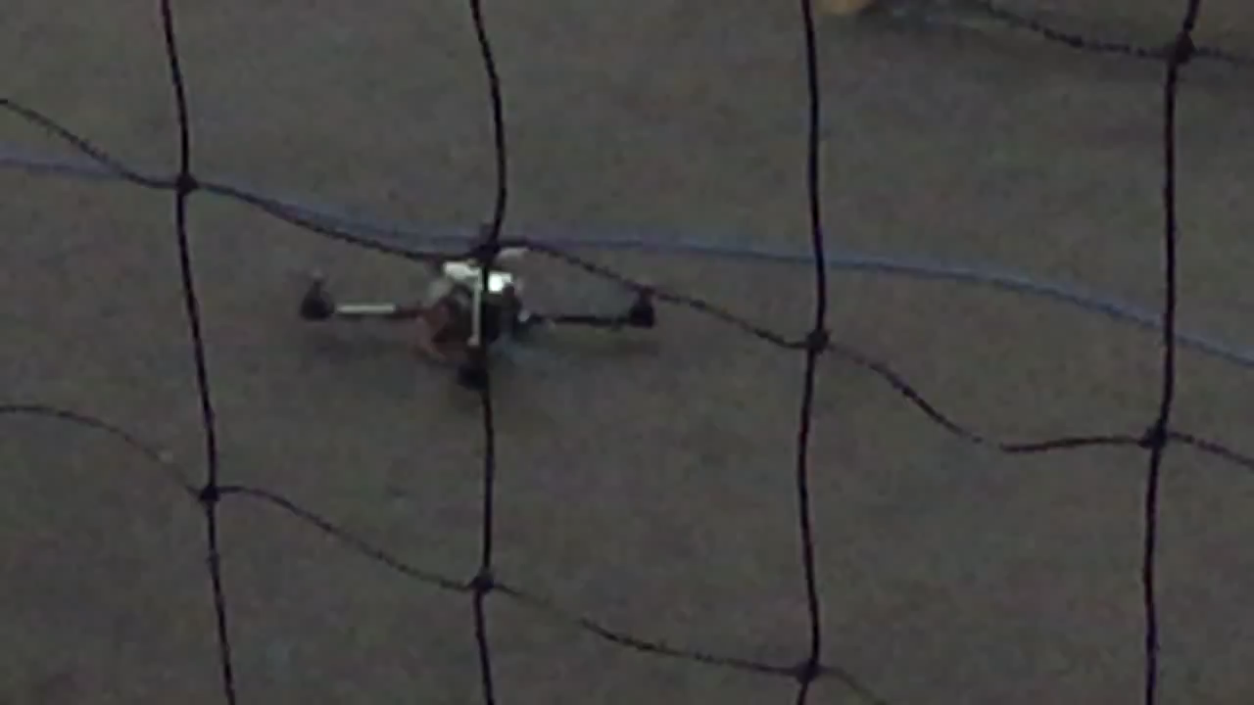
HulK SMASH Flipping

